Slide 1
Artificial intelligence
Physiotherapy Duration Prediction
Team 13
Sai manognya : 19K41A0582
Terala Hemanth : 19k41a0586
Shayaan Hussain : 19K41A04E6

Slide 2
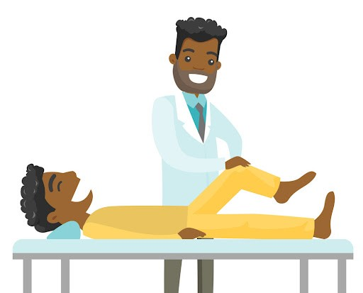
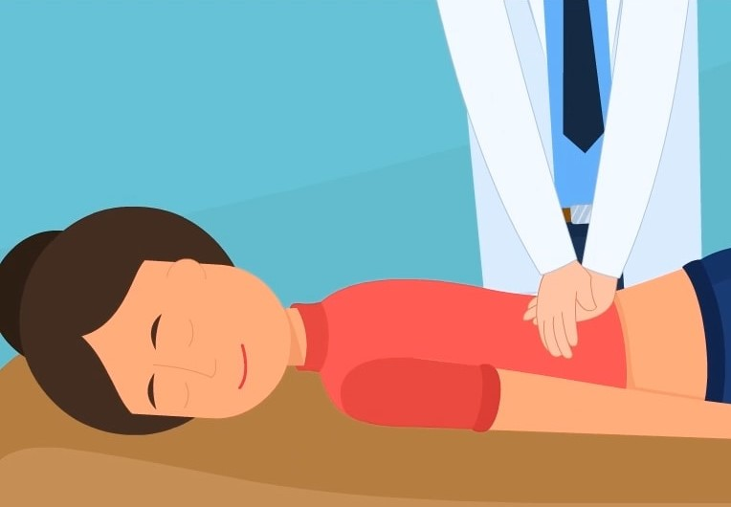
Introduction
Physiotherapy is a kind of treatment that deals with physical methods to cure a disease, injury or informity.

Slide 3
Objectives
To identify the duration of physiotherapy treatment to obtain maximum rehabilitation

Slide 4

Beneficiaries
Our project will help the physiotherapists and patients identify the expected duration of treatment

Slide 5
Dataset Insights
The model predicts the duration of physiotherapy using certain features. They are:
Age : (Age of person)
Affected Body Part : (Elbow, Knee etc)
Diagnosis : (Fracture, frozen shoulder etc)
Duration of Pain : (Acute, Sub-acute, Chronic)
Intensity of pain : (Intensity of pain on a scale of 1-9)
Treatment Approach : (Manual, Mechanical, Manual and Mechanical)
The Label will be number of days of physiotherapy

Slide 6
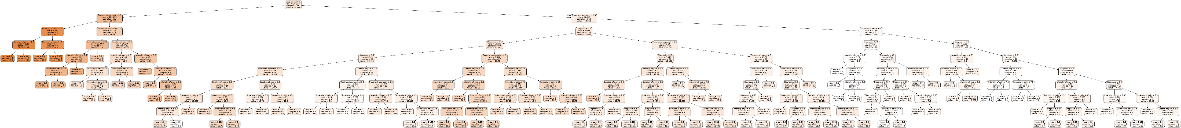
Machine learning model Used
We have used the Decision Tree Regressor model with a depth of 9 as we have got the best score and errors on it

Slide 7
Analysis:
 |  | Random Forest |  |  |  | Decision Tree |  |  |  | Linear Regression
 |  | N_Estimators |  |  |  | Max Depth
 |  | 100 | 50 | 25 | 10 | 10 | 9 | 8 | 7
Training | MAE | 0.37 | 0.37 | 0.37 | 0.34 | 0.13 | 0.16 | 0.3 | 0.42 | 1.67
 | MSE | 0.53 | 0.5 | 0.52 | 0.55 | 0.2 | 0.22 | 0.52 | 0.65 | 6.6
 | RMSE | 0.73 | 0.71 | 0.72 | 0.74 | 0.45 | 0.47 | 0.72 | 0.8 | 2.56
 | Score | 0.98 | 0.98 | 0.98 | 0.98 | 0.99 | 0.99 | 0.98 | 0.98 | 0.83
Testing | MAE | 0.76 | 0.73 | 0.77 | 0.68 | 0.61 | 0.54 | 0.67 | 0.71 | 1.57
 | MSE | 2.42 | 2.47 | 2.64 | 2.25 | 1.72 | 1.54 | 1.7 | 1.63 | 4.03
 | RMSE | 1.55 | 1.57 | 1.62 | 1.5 | 1.31 | 1.24 | 1.3 | 1.28 | 2
 | Score | 0.91 | 0.91 | 0.9 | 0.82 | 0.93 | 0.95 | 0.94 | 0.94 | 0.86

Slide 8
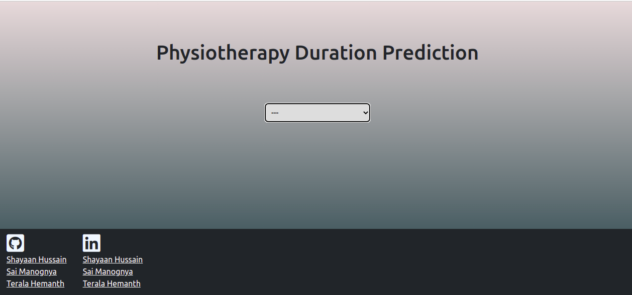
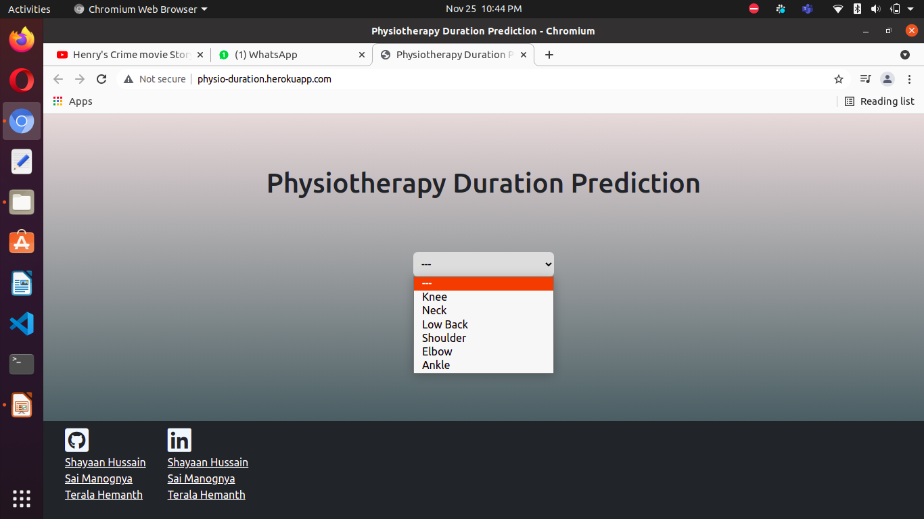
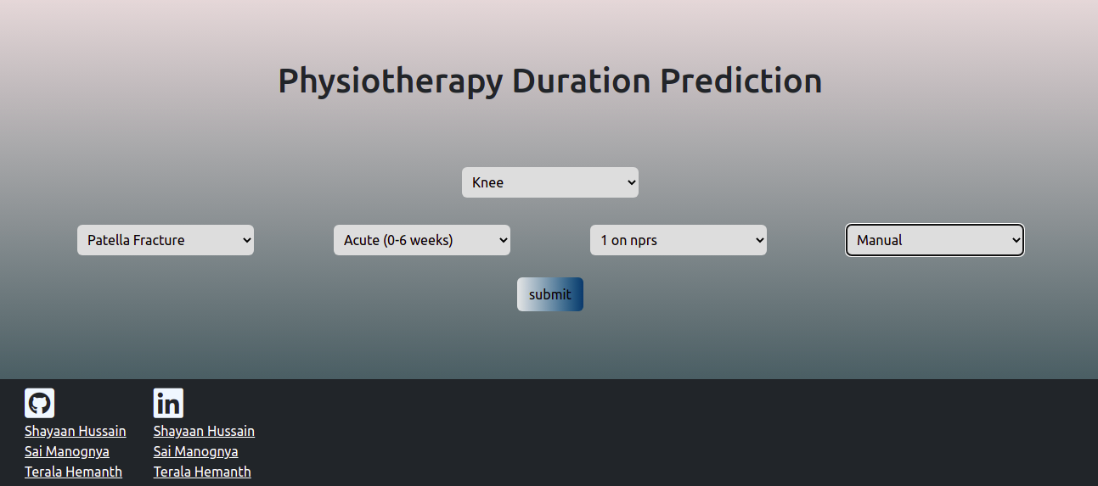

Web App
Live at: physio-duration.herokuapp.com

Slide 9
Conclusion and Future Scope
We can conclude that Decision Tree Regressor shows the best results with a training score 0.99 and testing score 0.95
This project can further be improved and can be embedded with more number of diagnosis to widen the target audience

Slide 10
Thank You

